Slide 1
LAR syndrome
Dr. Hoang Ngau Tran
UMC- Proctology Department

Slide 2
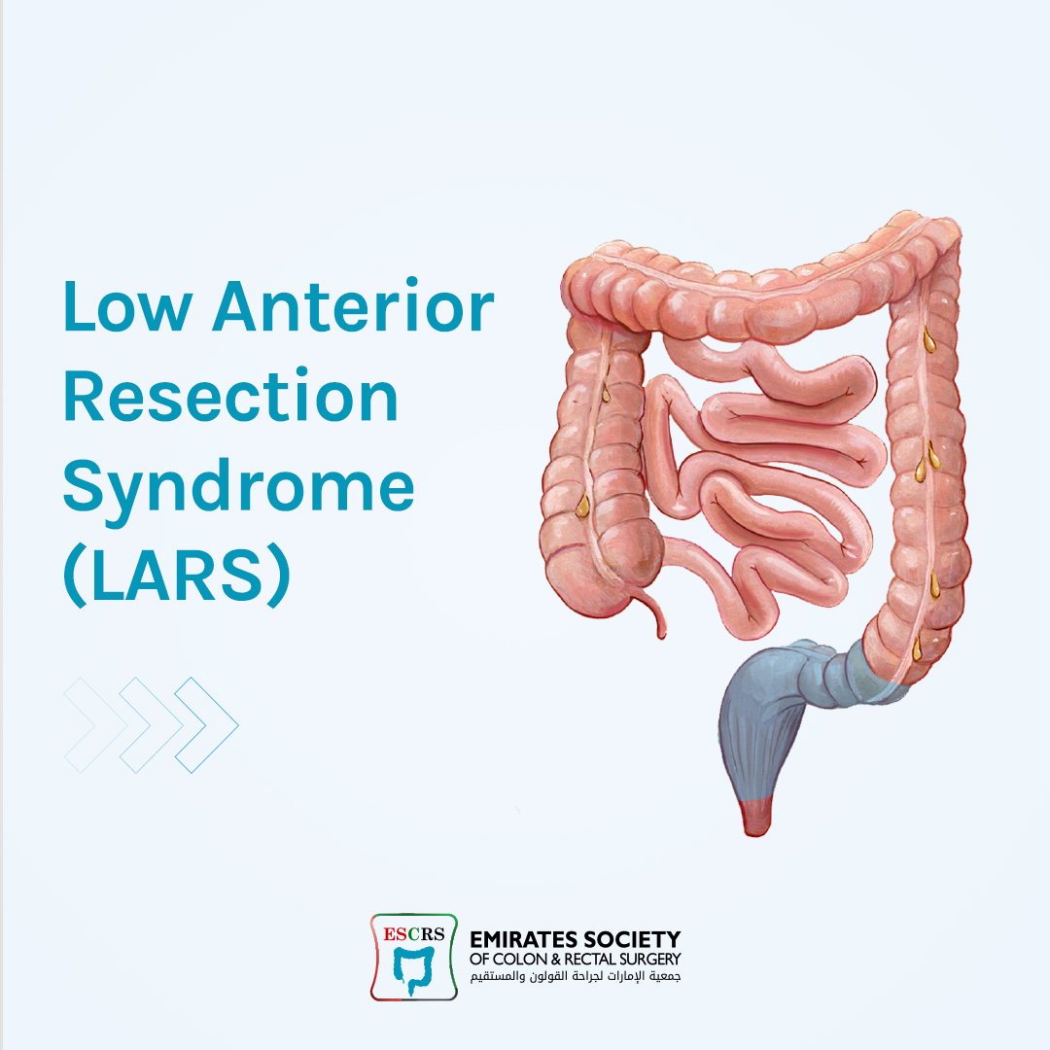
Content
Define symtoms of LARS
Pathophysiology
Pre- op considerations
Diagnosis and classify LARS
Manage LARS
McKenna NP, Dis Colon Rectum 2019;62 (12):1420-2

Slide 3
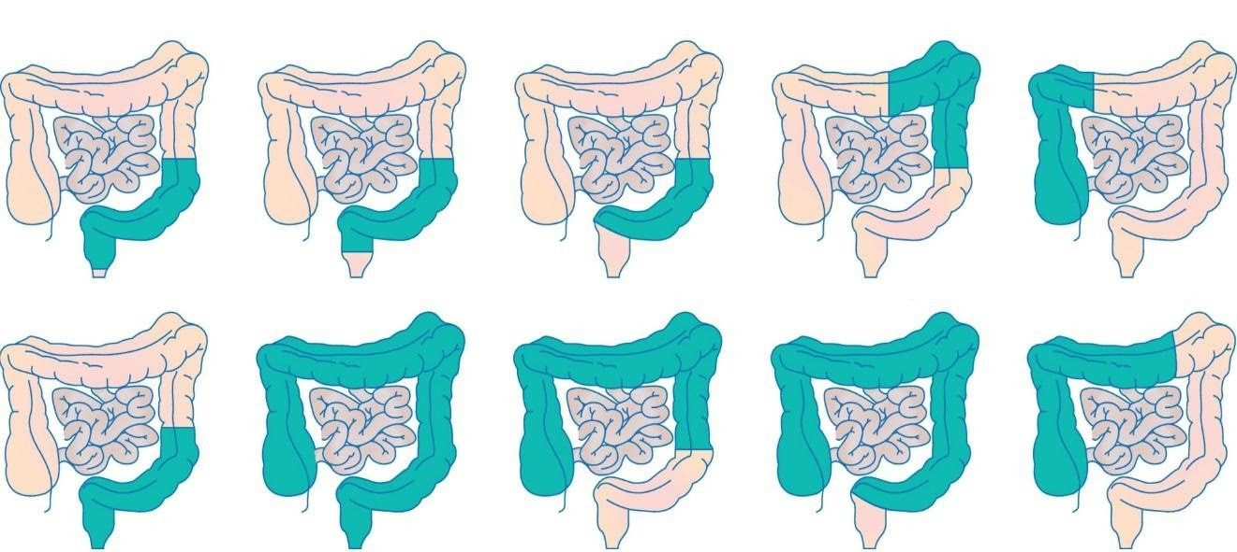
LARS
It is estimated that following a sphincter-sparing rectal surgery, 25-80% of patients develop low anterior resection syndrome (LARS), and the symptoms persist beyond 10 years in 50% of patients.

Slide 4
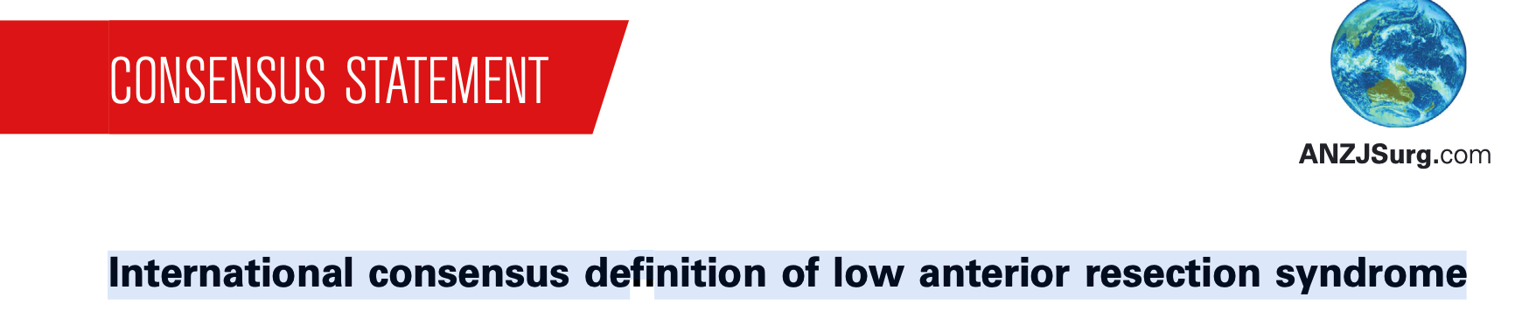
LARS
LARS has defined as ‘disordered bowel function after rectal resection, leading to a detriment in quality of life’
Low Anterior Resection Syndrome (LAR syndrome) is a collection symptoms or issues that people may have after surgery to resect or remove part of or the entire rectum.
Notes:
﻿Bryant CL, Lunniss PJ, Knowles CH et al. Anterior resection syndrome.
Lancet Oncol. 2012; 13: e403–8

Slide 5
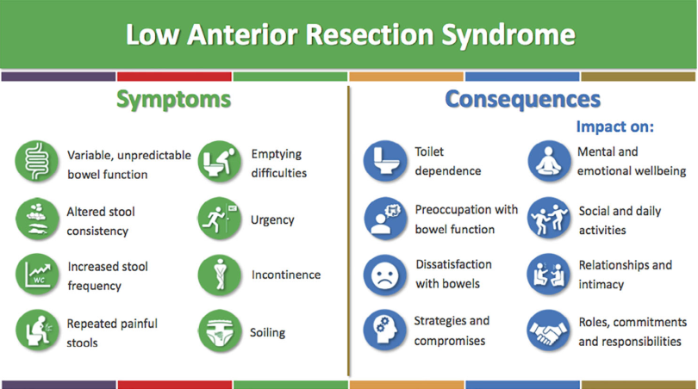
Notes:
International consensus definition of low anterior resection syndrome
February 2020
ANZ Journal of Surgery 90(3)
﻿Delphi survey- 325 mems

Slide 6
Pathophysiology
Consequence of sphincter- sparing surgery:
- Only treatment for rectal cancer
-Involves:
Removal of reservoir capacity
Post- op scarring
+/- sphincter dilation
Pre- op radiation
Post- op diversion and atrophy

Slide 7
Pathophysiology
Colonic dysmotility
Neorectal reservoir dysfuntion
- Denervation
- Reduced funtional capacity
Anal sphincter dysfunction

Slide 8
Symtoms
Fecal incontinence, urgency
Frequent BMs
Fragmented BMs, cluctering
Evacuation difficulty
Increased intestinal gas
Altered stool consistency
Notes:
BM. bowel movements

Slide 9
Risk factors
Post- op radiotherapy
Post- op chemotherapy
Low anastomosis
Total vs partial mesorectal excision
Temporary diverting stoma
Pre- op obstructive symptoms
Anastomotic complication

Slide 10
Diagnosis
Suspect: >= 1 bowel symtoms after sphincter- sparing operation
Confirm: symtoms persist >1 month and evaluation rules out other causes

Slide 11
Differential Diagnosis
Anastomotic failure
Anastomotics stricture
Ischemis colitis
Radiation proctitis
Pre- existing sphinter injury
Small intestinal bacterial overgrowth
Exacerbation of pre- existing IBS

Slide 12
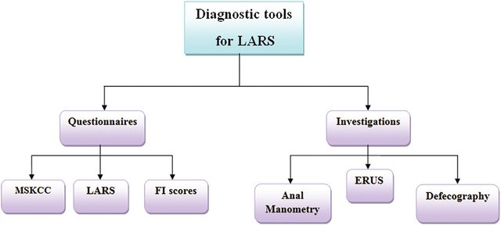
Diagnosis
Notes:
Diagnosis of low anterior resection syndrome. ERUS: Endorectal ultrasound; FI: Fecal incontinence; LARS: Low anterior resection syndrome score; MSKCC: Memorial Sloan Kettering Cancer Center.

Slide 13
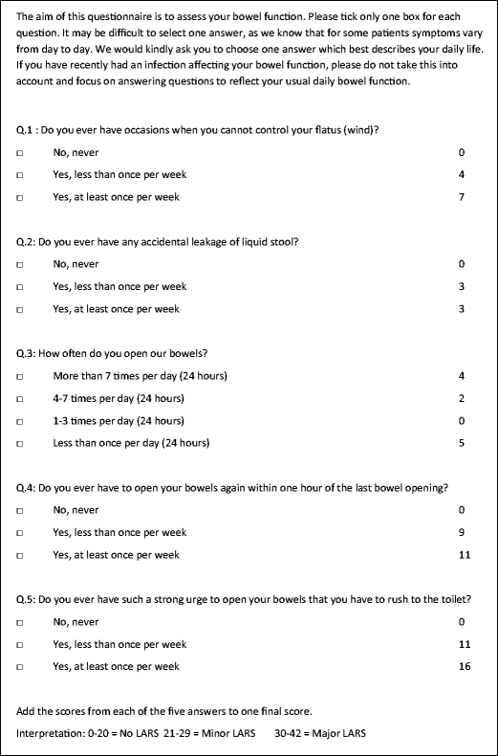
LARS SCORE
Widely used
Concise
Easy scoring
LARS based on 5 items of the LARS score, as described by Emmertsen and Laurberg³: incontinence for flatus and/or liquid stool, frequency of bowel movements, clustering of the stools, and fecal urgency. Respondents who scored <21 points did not have LARS. Respondents who scored 21 to 29 points experienced minor LARS, whereas 30 to 42 points indicated major LARS.
Notes:
LARS based on 5 items of the LARS score, as described by Emmertsen and Laurberg³: incontinence for flatus and/or liquid stool, frequency of bowel movements, clustering of the stools, and fecal urgency. Respondents who scored <21 points did not have LARS. Respondents who scored 21 to 29 points experienced minor LARS, whereas 30 to 42 points indicated major LARS.

Slide 14

MSKCC SCORE
2005
18 questions
Complex scoring- recoding

Slide 15
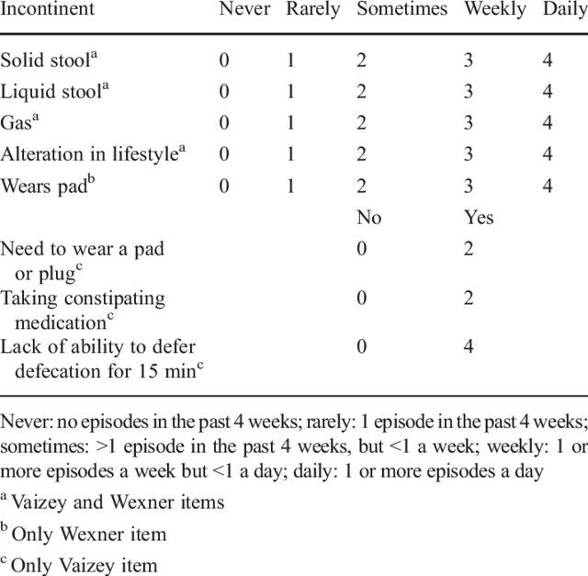
FI score
Notes:
St. Mark's incontinence score 6 Never Rarely Sometimes Weekly Daily

Slide 16
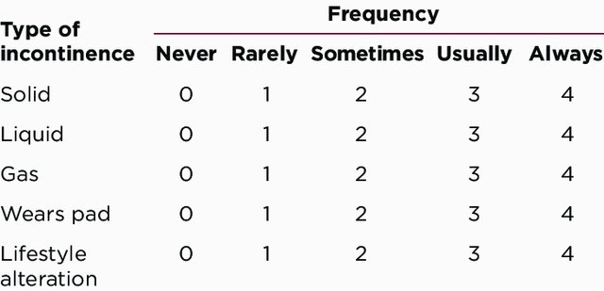
FI score
Cleveland Clinic Florida Fecal Incontinence Score (CCFFIS)

Slide 17
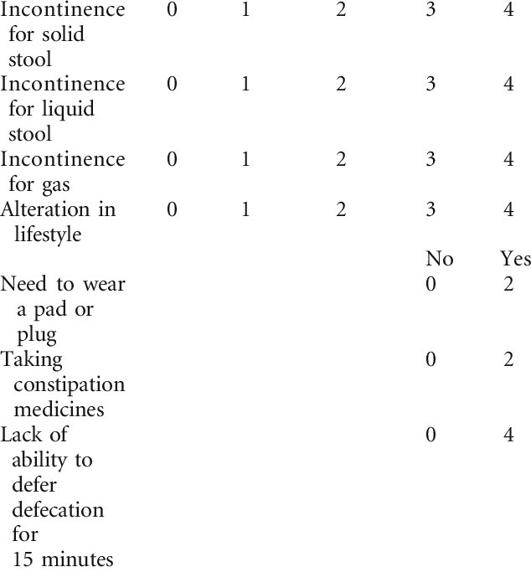
FI score
St. Mark's incontinence score 6 Never Rarely Sometimes Weekly Daily

Slide 18
Treatment
Notes:
reatment algorithm of low anterior resection syndrome. SNS: Sacral nerve stimulation; TAI: Transanal irrigation
Urgency → Ramosetron 5mcg
IBS→ Alsosetron, cilansetron
Gas n bloating→ simethicone
SIBO--> Rifaxamin, Neomycin

Slide 19
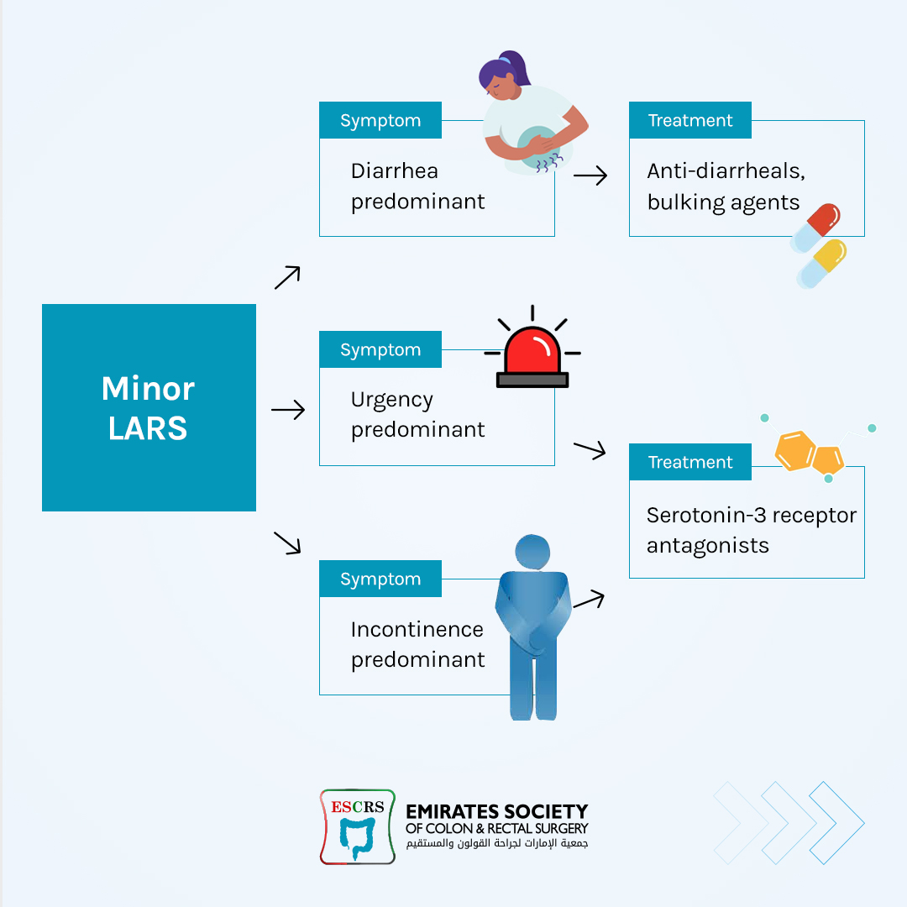
Treatment
Notes:
SIBO→ Rifaxamin, Neomycin
Urgency → 5mcg Ramosetron
IBS→ Alsosetron, Cilansetron

Slide 20
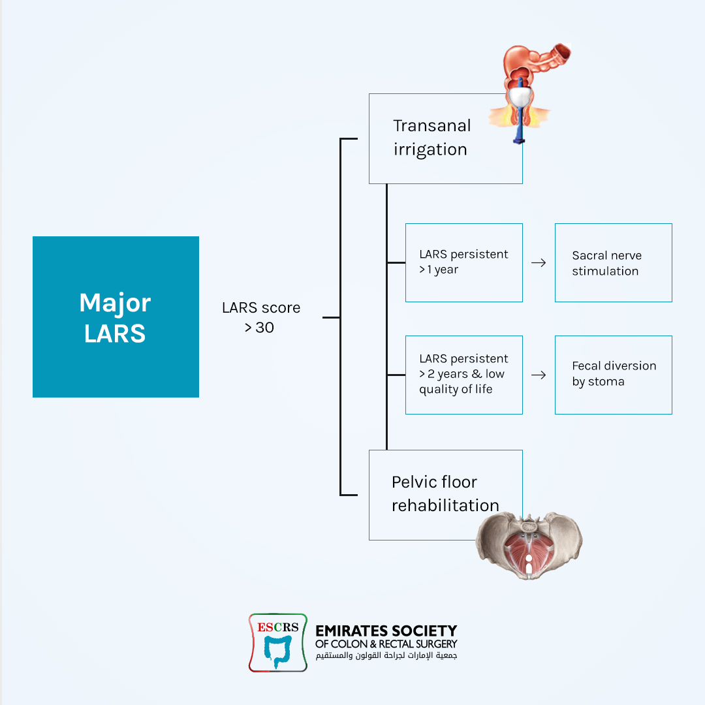
Treatment
Notes:
Pelvic floor rehabilitation:
Biofeedback
Pelvic floor muscle training
Electrostimulation
Volumetric/ rectal balloon training
Cobination of techniques

Slide 21
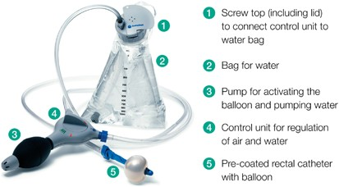
Transanal irrigation
https://www.coloplastprofessional.co.uk/bowel-management/resources/

Slide 22
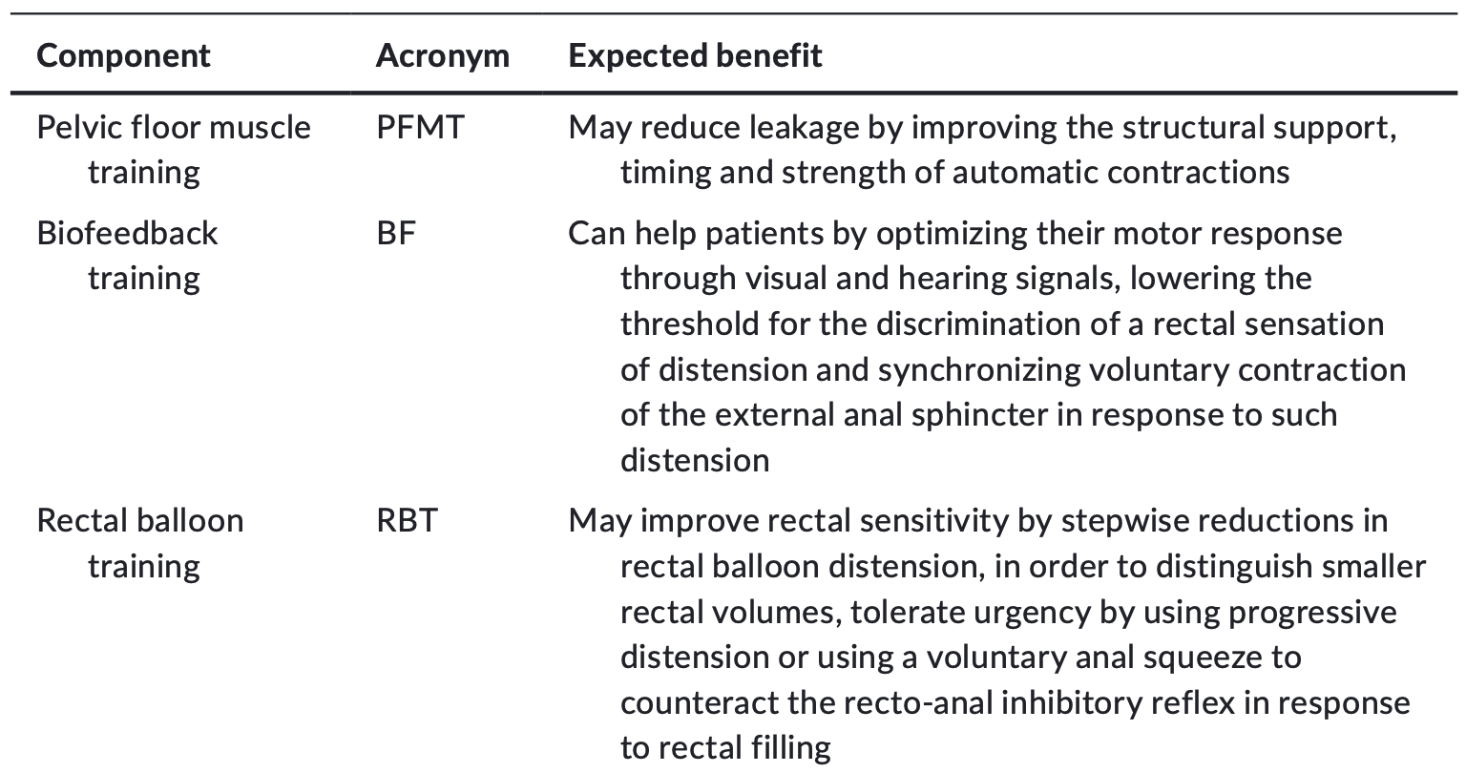
Pelvic floor rehabilitation

Slide 23
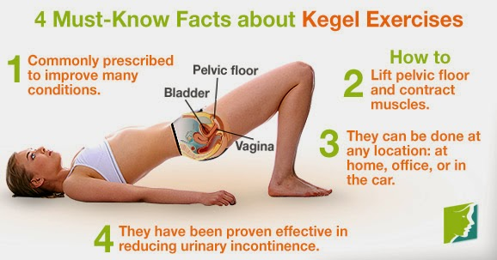
What can help to decrease LAR symptoms?
Kegel exercises that help to strengthen the muscles combined with dietary changes may help with urgency and stool incontinence.

Slide 24
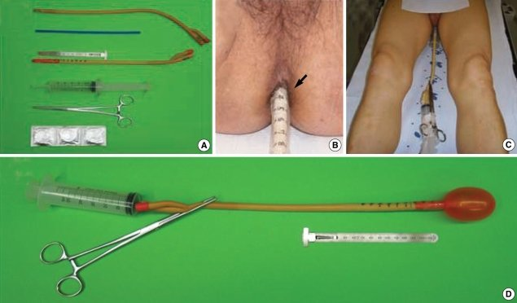
Rectal ballon training
Constituents of the rectal balloon.
Measurement of the insertion depth of the rectal balloon using a marked scale on the rectal tube (black arrow).
Pre-treatment supine position.
Inflated rectal balloon.

Slide 25

Food chart
Foods that can cause gas
Cabbage
Dairy products
Brussels sprouts
Spinach
Broccoli
Radishes
Cauliflower
Carbonated beverages
Onions
Beans
Corn
Cucumbers
Nuts
Beer

Slide 26
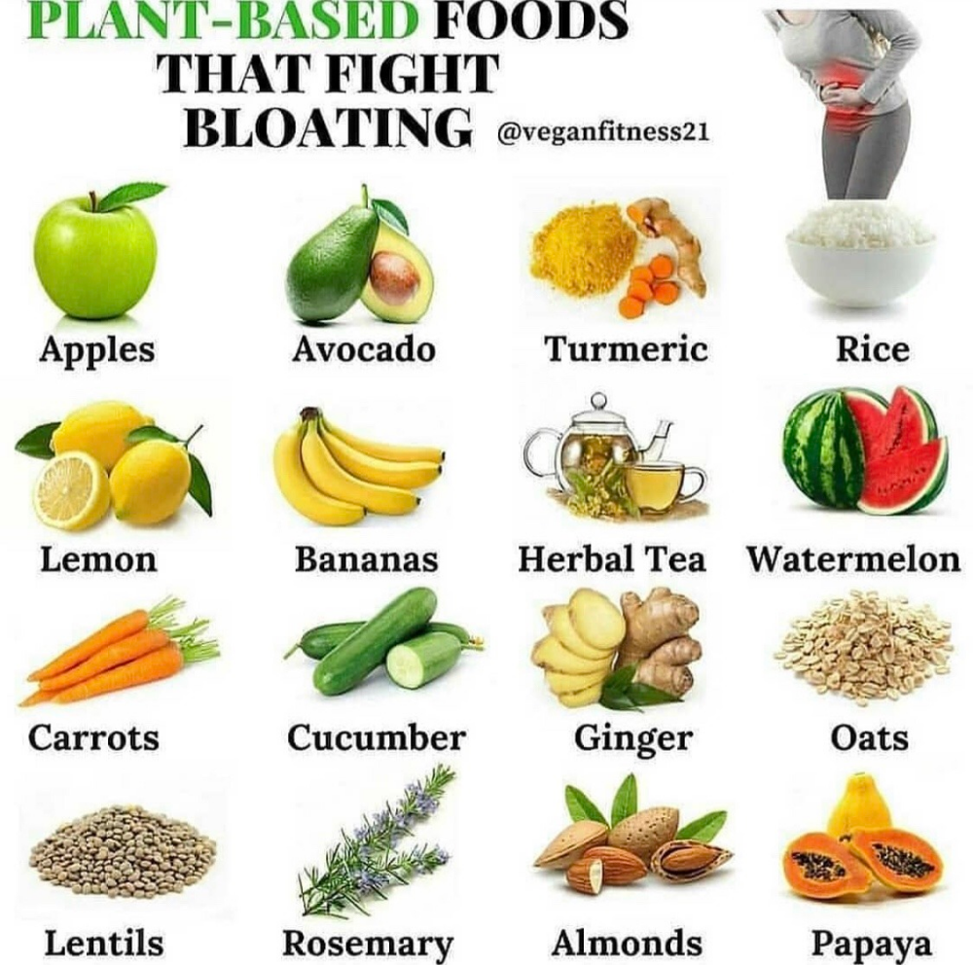
Food chart
Foods that make stools firmer
Bananas
White boiled rice
White pasta
White bread (not high fiber)
Milk Arrowroot biscuits
Marshmallows (white)
Tapioca
Peanut butter
Potatoes
Cheese
Yogurt
Pretzels

Slide 27
Food chart
Foods that may cause softer and more frequent stools
Vegetables: red capsicum, cabbage, onions, spinach, dried and fresh beans, peas, corn, Brussels sprouts and broccoli
Fruit: Fresh, canned or dried fruit; grapes, apricots, peaches, plums and prunes
Spices: Chili, curry and garlic
Caffeine: Coffee, tea, cola and chocolate
Alcohol: beer and red wine

Slide 28
Foods that may cause softer and more frequent stools
Glucose-free foods containing Sorbitol or Mannitol: Sugar free chewing gum, some mints, sweeteners and snack bars
Bran, other high fiber cereals and breads as well as some fiber supplements
Milk and other dairy products
Nuts and popcorn
Greasy foods
Prune, orange and grape juice

Slide 29
SUMMARY
Common
Persistent- up to 46%- 14 yrs
Active prevention
Multimodal management

Slide 30
THANK FOR YOUR ATTENTION

